Slide 1
Input group
Taught by Yossef Ayman Zedan

Slide 2
Basic example
We can add add-on or a button on either side of the input (right or left) but remember to add the label outside of the input group:
At the left side:
<div class="input-group mb-3"> <span class="input-group-text" id="basic-addon1">@</span> <input type="text" class="form-control" placeholder="Username"> </div> At the right side:
<div class="input-group mb-3"> <input type="text" class="form-control" placeholder="Recipient's username"> <span class="input-group-text" id="basic-addon2">@example.com</span> </div>

Slide 3
Basic example
Left side with label:
<label for="basic-url" class="form-label">Your vanity URL</label> <div class="input-group mb-3"> <span class="input-group-text" id="basicaddon3">https://example.com/users/</span> <input type="text" class="form-control" id="basic-url" > </div>
Both sides:
<div class="input-group mb-3"> <span class="input-group-text">$</span> <input type="text" class="form-control”> <span class="input-group-text">.00</span> </div>

Slide 4
Basic example
At the center
<div class="input-group mb-3">
<input type="text" class="form-control" placeholder="Username"> <span class="input-group-text">@</span> <input type="text" class="form-control" placeholder="Server"> </div> Textarea:
<div class="input-group"> <span class="input-group-text">With textarea</span> <textarea class="form-control"></textarea> </div>

Slide 5
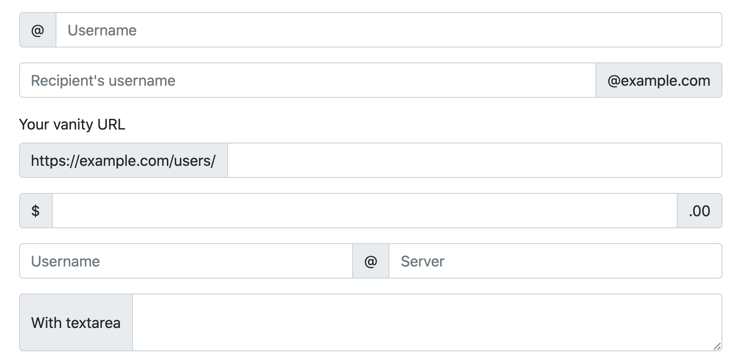
Basic example

Slide 6
Wrapping
Input groups wrap if we don’t specify that we don’t want it to wrap because it has flex-wrap: wrap; in the CSS. We can add “flex-nowrap” class to give it flex-wrap: no-wrap; if we don’t want it to wrap
Source code:
<div class="input-group flex-nowrap"> <span class="input-group-text" id="addon-wrapping">@</span> <input type="text" class="form-control" placeholder="Username"> </div>

Slide 7
Sizing
Add the relative form sizing classes to the .input-group itself and contents within will automatically resize—no need for repeating the form control size classes on each element.
Sizing on the individual input group elements isn’t supported.
For small:
<div class="input-group input-group-sm mb-3"> </div> For medium we don’t add any additional classes:
<div class="input-group mb-3"> </div> For large:
<div class="input-group input-group-lg"> </div>

Slide 8
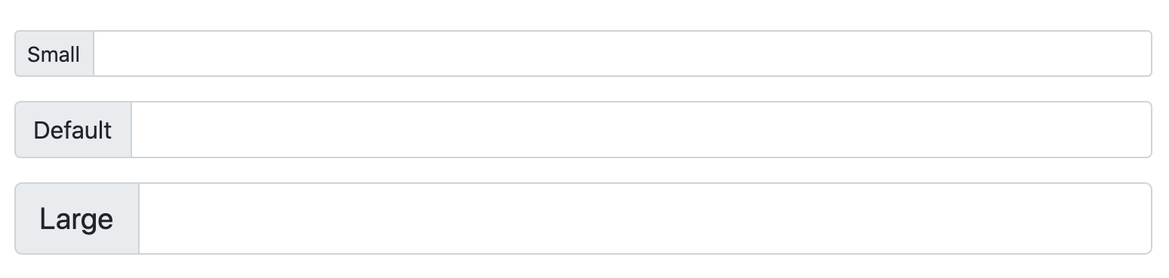
Sizing

Slide 9
Checkboxes and radios
Place any checkbox or radio option within an input group’s addon instead of text. .mt-0 is recommended to be added to the .form-check-input when there’s no visible text next to the input.
Checkbox:
<div class="input-group mb-3"> <div class="input-group-text"> <input class="form-check-input mt-0" type="checkbox" value=""> </div> <input type="text" class="form-control"> </div> Radio:
<div class="input-group"> <div class="input-group-text"> <input class="form-check-input mt-0" type="radio" value=""> </div> <input type="text" class="form-control"> </div>

Slide 10
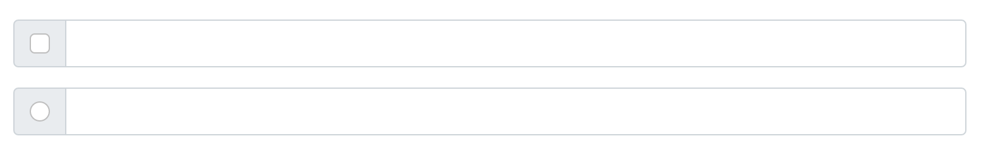
Checkboxes and radios

Slide 11
Multiple inputs
While multiple <input>s are supported visually, validation styles are only available for input groups with a single <input>.
<div class="input-group"> <span class="input-group-text">First and last name</span> <input type="text" class="form-control"> </div>

Slide 12
Multiple addons
Multiple add-ons are supported and can be mixed with checkbox and radio input versions.
Source code:
<div class="input-group mb-3"> <span class="input-group-text">$</span> <span class="input-group-text">0.00</span> <input type="text" class="form-control"> </div>
<div class="input-group"> <input type="text" class="form-control"> <span class="input-group-text">$</span> <span class="input-group-text">0.00</span> </div>

Slide 13
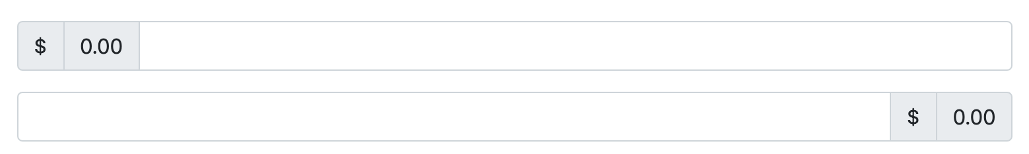
Multiple addons

Slide 14
Button addons
Source code:
At the left
<div class="input-group mb-3">
<button class="btn btn-outline-secondary" type="button" id="button-addon1">Button</button>
<input type="text" class="form-control" placeholder="">
</div>
At the right
<div class="input-group mb-3">
<input type="text" class="form-control" placeholder="Recipient's username">
<button class="btn btn-outline-secondary" type="button" id="button-addon2">Button</button>
</div>

Slide 15
Button addons
Two at the left
<div class="input-group mb-3"> <button class="btn btn-outline-secondary" type="button">Button</button> <button class="btn btn-outline-secondary" type="button">Button</button> <input type="text" class="form-control" placeholder="”> </div>
Two at the right
<div class="input-group"> <input type="text" class="form-control" placeholder="Recipient's username"> <button class="btn btn-outline-secondary" type="button">Button</button> <button class="btn btn-outline-secondary" type="button">Button</button> </div>

Slide 16
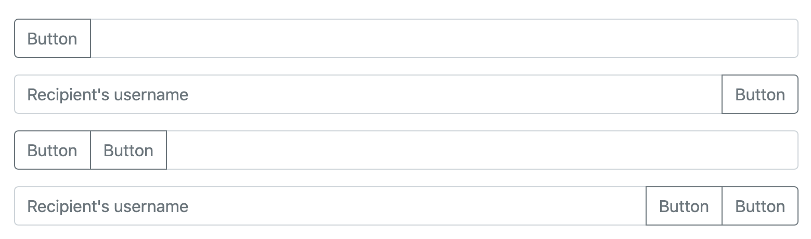
Button addons

Slide 17
Buttons with dropdowns Dropdown
Dropdown at the left
<div class="input-group mb-3"> <button class="btn btn-outline-secondary dropdown-toggle" type="button" data-bs-toggle="dropdown" >Dropdown</button> <ul class="dropdown-menu">
<li><a class="dropdown-item" href="#">Action</a></li> </ul> <input type="text" class="form-control" > </div>

Slide 18
Buttons with dropdowns Dropdown
Dropdown at the right
<div class="input-group mb-3"> <input type="text" class="form-control"> <button class="btn btn-outline-secondary dropdown-toggle" type="button" data-bs-toggle="dropdown”>Dropdown</button>
<ul class="dropdown-menu dropdown-menu-end"> <li><a class="dropdown-item" href="#">Action</a></li> </ul> </div>

Slide 19
Buttons with dropdowns Dropdown
Dropdown at both sides with input at the center
<div class="input-group"> <button class="btn btn-outline-secondary dropdown-toggle" type="button" data-bs-toggle="dropdown" >Dropdown</button> <ul class="dropdown-menu"> <li><a class="dropdown-item" href="#">Action before</a></li> </ul> <input type="text" class="form-control”> <button class="btn btn-outline-secondary dropdown-toggle" type="button" data-bs-toggle="dropdown">Dropdown</button> <ul class="dropdown-menu dropdown-menu-end"> <li><a class="dropdown-item" href="#">Action</a></li> </ul> </div>

Slide 20
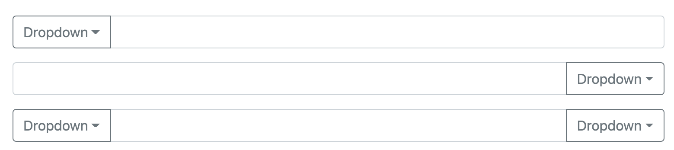
Buttons with dropdowns Dropdown

Slide 21
Segmented buttons
At the left:
<div class="input-group mb-3"> <button type="button" class="btn btn-outline-secondary">Action</button> <button type="button" class="btn btn-outline-secondary dropdown-toggle dropdown-toggle-split" data-bs-toggle="dropdown"> <span class="visually-hidden">Toggle Dropdown</span>
</button> <ul class="dropdown-menu"> <li><a class="dropdown-item" href="#">Action</a></li> </ul> <input type="text" class="form-control"> </div>

Slide 22
Segmented buttons
At the right:
<div class="input-group mb-3"> <input type="text" class="form-control">
<button type="button" class="btn btn-outline-secondary">Action</button> <button type="button" class="btn btn-outline-secondary dropdown-toggle dropdown-toggle-split" data-bs-toggle="dropdown"> <span class="visually-hidden">Toggle Dropdown</span>
</button> <ul class="dropdown-menu dropdown-menu-end"> <li><a class="dropdown-item" href="#">Action</a></li> </ul> </div>

Slide 23
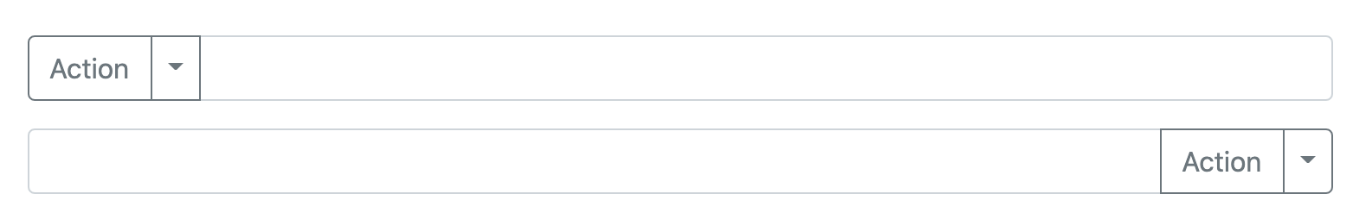
Segmented buttons

Slide 24
Custom select
Input groups include support for custom selects and custom file inputs. Browser default versions of these are not supported.
Label at the left side:
<div class="input-group mb-3"> <label class="input-group-text" for="inputGroupSelect01">Options</label> <select class="form-select" id="inputGroupSelect01"> <option selected>Choose...</option> <option value="1">One</option> </select> </div>

Slide 25
Custom select
Input groups include support for custom selects and custom file inputs. Browser default versions of these are not supported.
Label at the right side:
<div class="input-group mb-3"> <select class="form-select" id="inputGroupSelect02"> <option selected>Choose...</option> <option value="1">One</option> </select>
<label class="input-group-text" for="inputGroupSelect02">Options</label> </div>

Slide 26
Custom select
Input groups include support for custom selects and custom file inputs. Browser default versions of these are not supported.
Select with button at the left:
<div class="input-group mb-3"> <button class="btn btn-outline-secondary" type="button">Button</button> <select class="form-select" id="inputGroupSelect03"> <option selected>Choose...</option> <option value="1">One</option> </select> </div>

Slide 27
Custom select
Input groups include support for custom selects and custom file inputs. Browser default versions of these are not supported.
Select with button at the right:
<div class="input-group"> <select class="form-select" id="inputGroupSelect04" > <option selected>Choose...</option> <option value="1">One</option> </select> <button class="btn btn-outline-secondary" type="button">Button</button> </div>

Slide 28
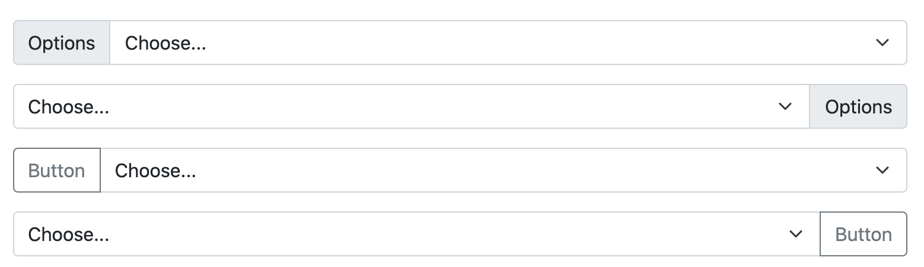
Custom select

Slide 29
Custom file input
Label at the left side:
<div class="input-group mb-3"> <label class="input-group-text" for="inputGroupFile01">Upload</label> <input type="file" class="form-control" id="inputGroupFile01"> </div> Label at the right side:
<div class="input-group mb-3"> <input type="file" class="form-control" id="inputGroupFile02"> <label class="input-group-text" for="inputGroupFile02">Upload</label> </div> Button at the left
<div class="input-group mb-3"> <button class="btn btn-outline-secondary" type="button” id="inputGroupFileAddon03">Button</button> <input type="file" class="form-control" id="inputGroupFile03"> </div>

Slide 30
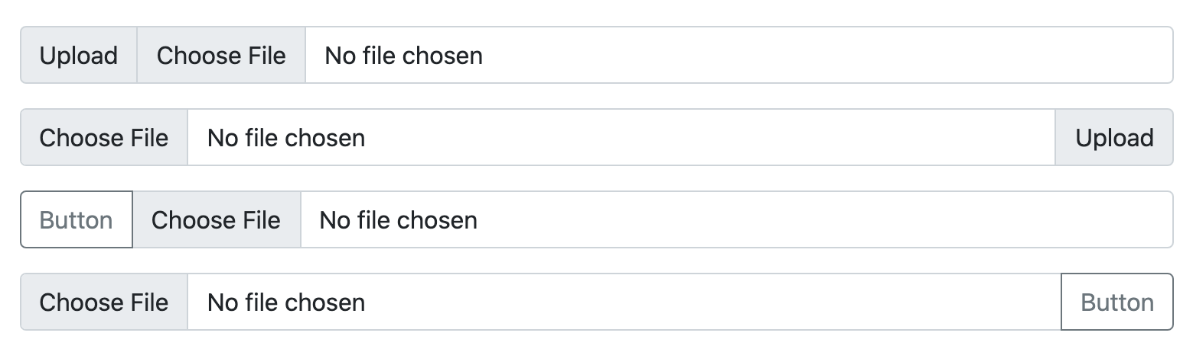
Custom file input
Button at the right:
<div class="input-group"> <input type="file" class="form-control" id="inputGroupFile04">
<button class="btn btn-outline-secondary" type="button" id="inputGroupFileAddon04">Button</button> </div>

